Slide 1

Rogel and Blondy Center for Pancreatic Cancer
Bulk RNA-seq analysis workshop
Aaron denDekker
Assistant Research Scientist | Bioinformatics Lead
October 29, 2025

Slide 2
Quick introduction to the workshop
About me
Assistant Research Scientist in Molecular & Integrative Physiology
Bioinformatics Lead for the Rogel and Blondy Center for Pancreatic Cancer
PhD in Biochemistry & Molecular Biology
University of Louisville
At University of Michigan since 2013
Postdoc with Yali Dou
Epigenetics and Transcriptional Regulation
Research Investigator with Kathy Gallagher
Epigenetic regulation of immunity
Bioinformatics Scientist at Advaita

Slide 3
Quick introduction to the workshop
GitHub page
https://github.com/aarondendekker/Bulk_RNA-seq_workshop_Oct2025
Slide deck – posted after the workshop
Toy data set
Code in .Rmd format
Other helpful materials
Evaluation after the workshop
What did you like?
What did you hate?
What topics would you like to see covered in future workshops?
Office hours
Every Monday afternoon from 1 – 5 pm
Sign up @ https://docs.google.com/spreadsheets/d/1pFDt4khTjsR1bOjdtWaKQFNA1KCEPSWBf6bB_7_Uy6o/edit?gid=0#gid=0

Slide 4

The Goal(s) of this workshop
At the end of this workshop, you should be:
Comfortable installing and running packages in R
Familiar with the Great Lakes HPC
Able to perform differential expression analysis on bulk RNA-seq data
Able to make plots to visualize your data
Able to use GSEA to glean mechanistic insight
The ultimate goal is for you to be comfortable accessing your data and performing basic analysis of bulk RNA-seq data

Slide 5
Agenda
Time | Topic
10:00 – 10:15 | General Introduction
10:15 – 10:30 | Introduction to the Great Lakes HPC cluster and Globus
10:30 – 11:00 | Initial processing of bulk RNA-seq data
11:00 – 11:30 | Introduction to R and RStudio
11:30 - 12:00 | Importing data into RStudio and exploratory analysis
12:00 - 1:00 | Break for lunch
1:00-2:00 | Differential expression analysis with DESeq2
2:00-4:00 | Making sense of differential expression data

Slide 6
Introduction to the Great Lakes HPC cluster and Globus

Slide 7

Great Lakes HPC Cluster
Used for storing, processing, and archiving data.
Provides up to 180 GB of memory on 36 cores for a standard partition and up to 1503 GB of memory on 36 cores for a large memory partition.
Can be accessed via command line, interactively via virtual environment, or Globus.
Armis2 is almost identical to Great Lakes
More robust security for PHI
Maintained by Advanced Research Computing (ARC)
Navigating the ARC website for information on Great Lakes is terrible

Slide 8
Ways to access Great Lakes
Command line via Terminal
Login instructions:
Open Terminal on Mac or Windows Terminal on Windows
Type in: ssh your_uniqname@greatlakes.arc-ts.umich.edu
Input your level 2 password
Type 1 for DUO Security
This is the method you want to use if you want to run command line-based process
Interactive Virtual Machine
Requires access to a Slurm account
Given to PIs with Research Computing Package
Will need PI to grant you access
Login instructions:
Navigate to dashboard here
Select RStudio or Basic Desktop from the “Interactive Apps” dropdown tab
Input the required settings into the form
Select Launch
This is the method you want to use if you want to run Rstudio in Great Lakes

Slide 9
Globus
Link to Globus @ https://www.globus.org
ARC’s preferred method for moving large amounts of data between drives on the computing cluster.
Can also be used to move data between personal devices and the computing cluster.
For personal devices, you must have Globus Connect Personal installed and running.
Download Globus Connect Personal here

Slide 10
Initial processing of bulk RNA-seq data

Slide 11
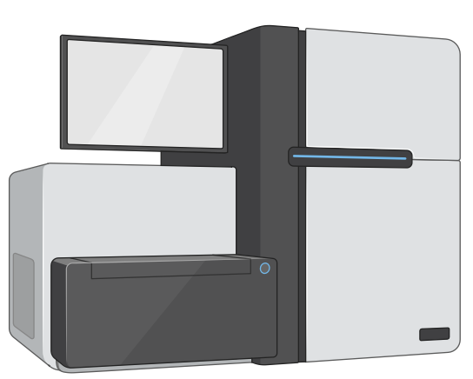
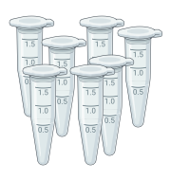
The standard bulk RNA-seq workflow
Raw reads
QC
fastqc
Quality Trimming
Trimmomatic
Command line
Alignment
STAR
Feature counting
RSEM
Exploratory analysis
PCA, Heatmaps
Differential expression
DESeq2
R
Visualization
Volcano Plot
Pathway analysis
GSEA
topGO, KEGG, Reactome, GSEA, etc.

Slide 12


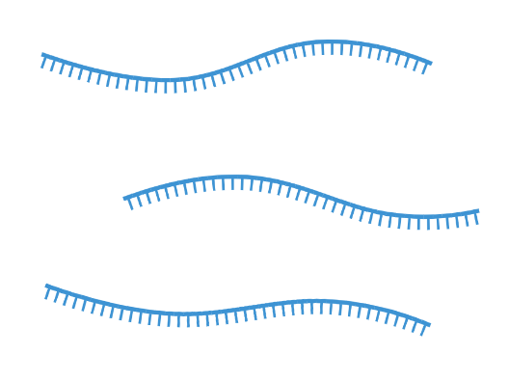
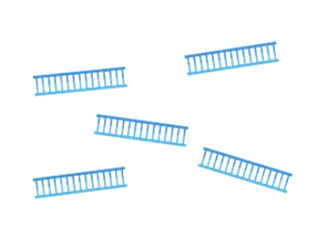
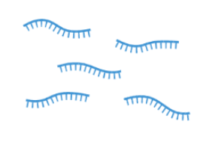

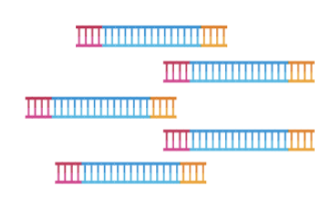
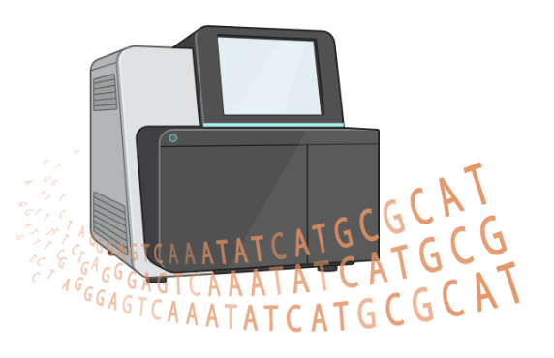
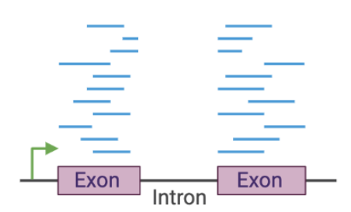
Bulk RNA-seq workflow
Library Preparation
Isolate RNA
Fragment RNA
Reverse transcribe to cDNA
Library Preparation
Ligate adapters and amplify
Sequence
Process reads and align

Slide 13
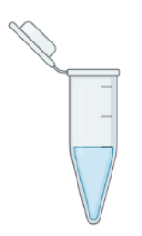


Barcoding allows for samples to be multiplexed
Fragment
cDNA
Ligate with barcoded adapters & amplify
Pool samples & sequence on the same lane
Demultiplex using barcodes
Align to transcriptome
Sample A
Sample B

Slide 14
The standard bulk RNA-seq workflow
Raw reads
QC
fastqc
Quality Trimming
Trimmomatic
Alignment
STAR
Feature counting
RSEM
Exploratory analysis
PCA, Heatmaps
Differential expression
DESeq2
Visualization
Volcano Plot
Pathway analysis
GSEA
topGO, KEGG, Reactome, GSEA, etc.

Slide 15
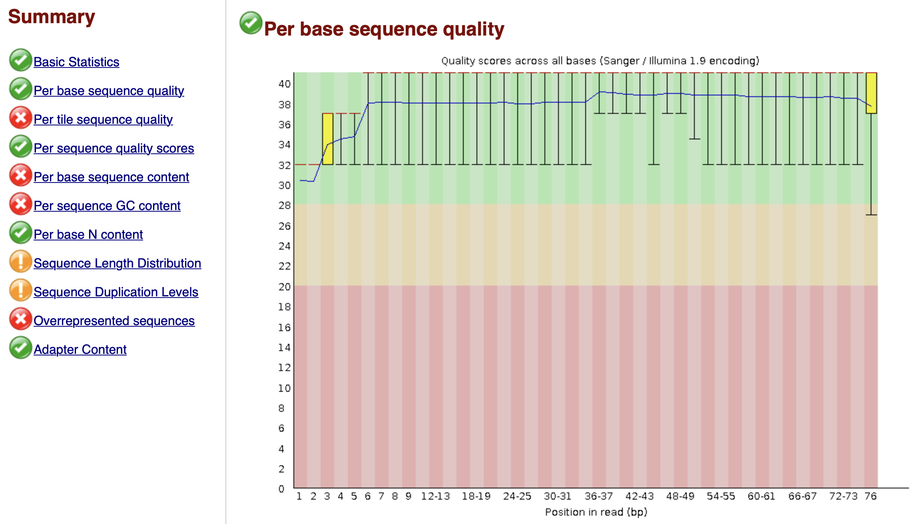
FastQC

Slide 16
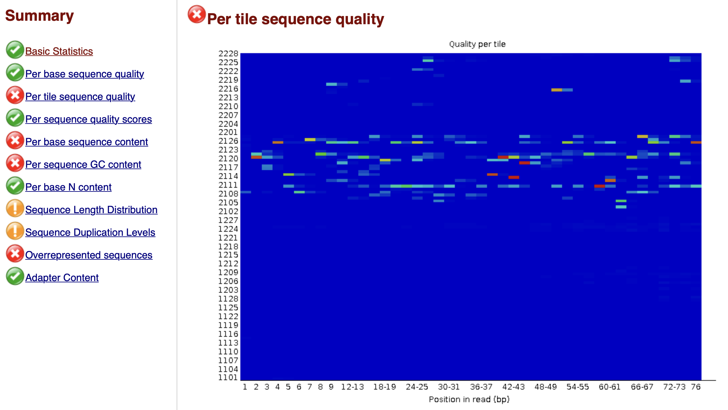
FastQC

Slide 17
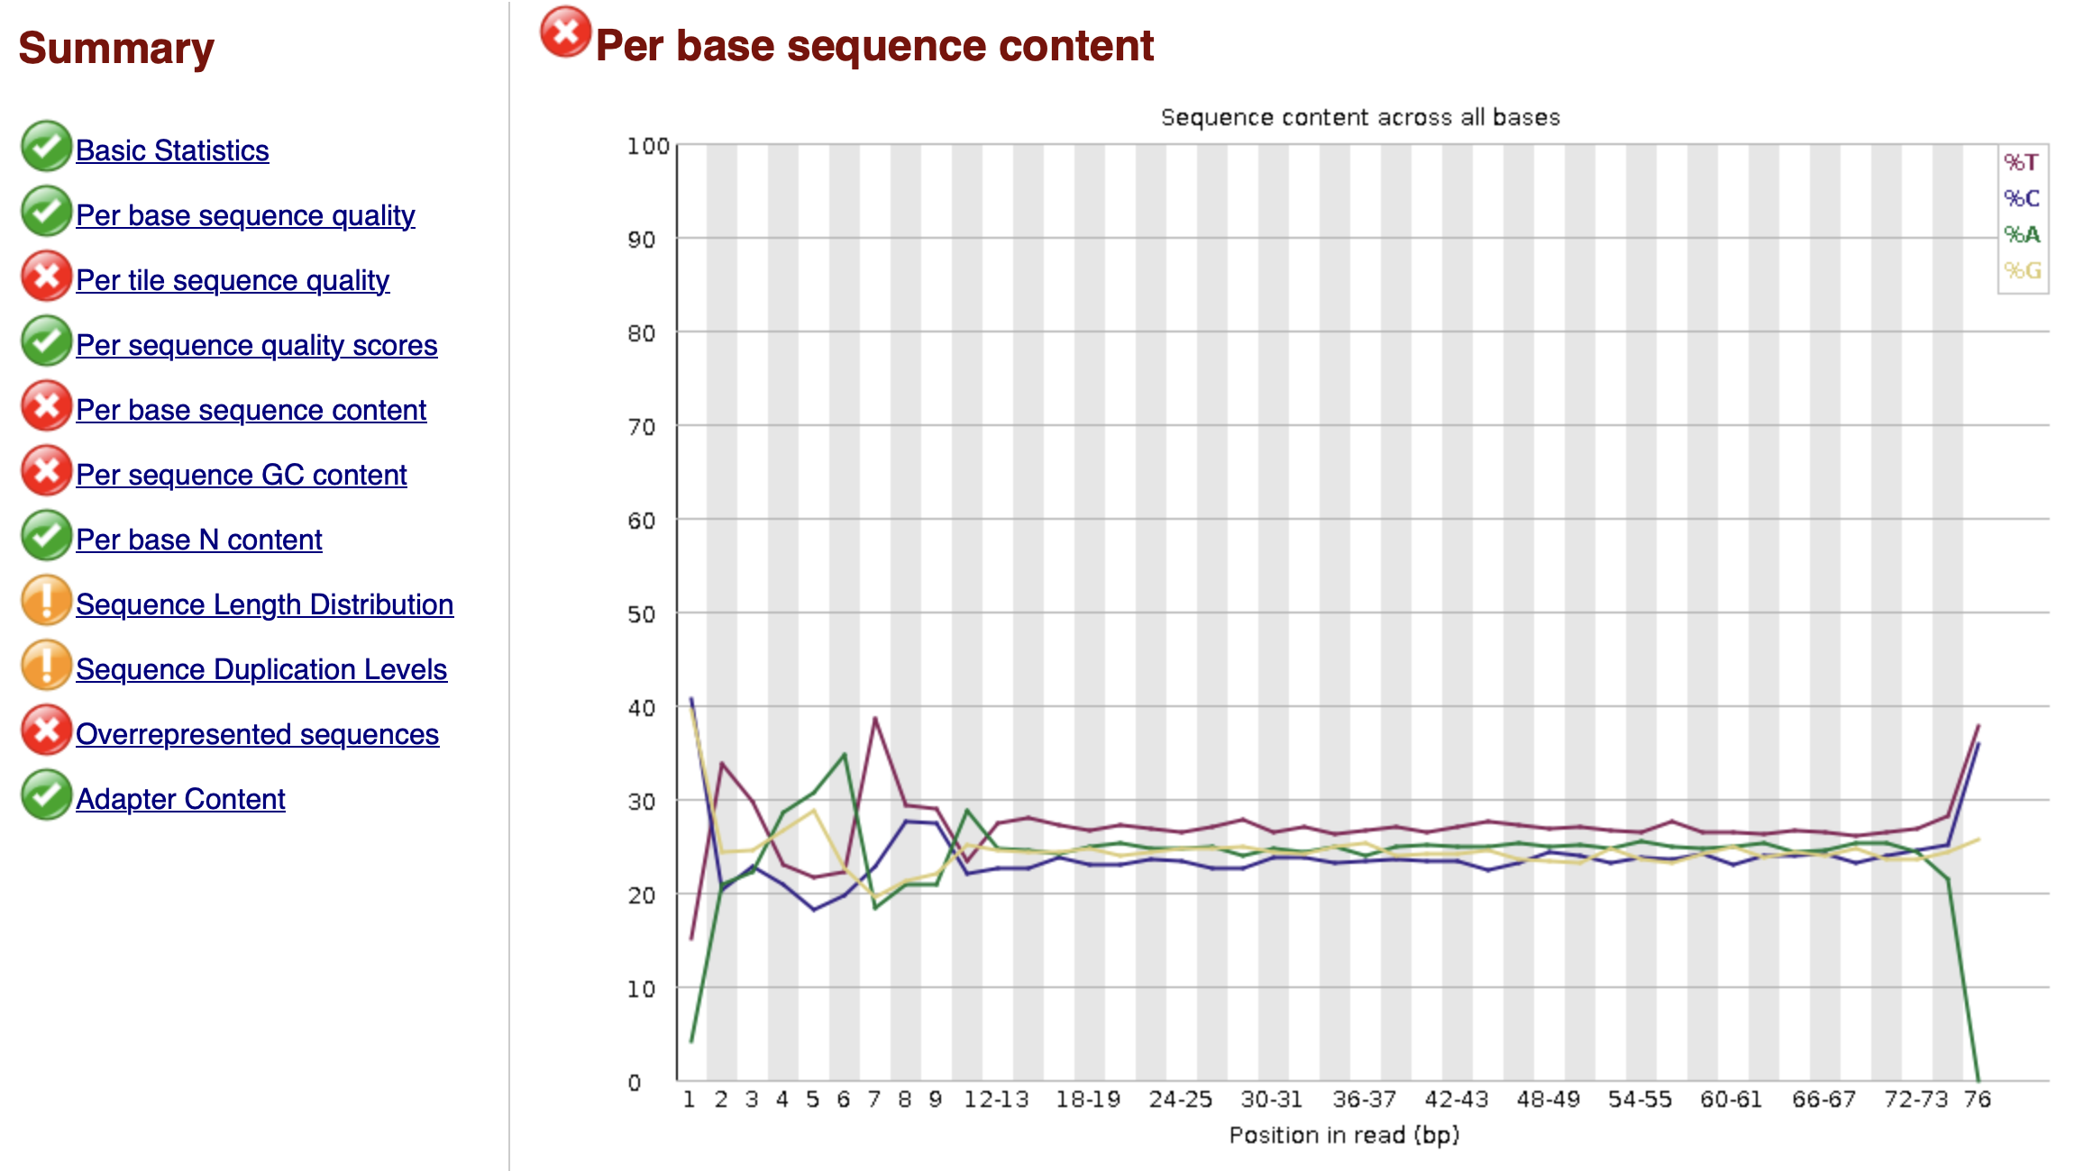
FastQC

Slide 18
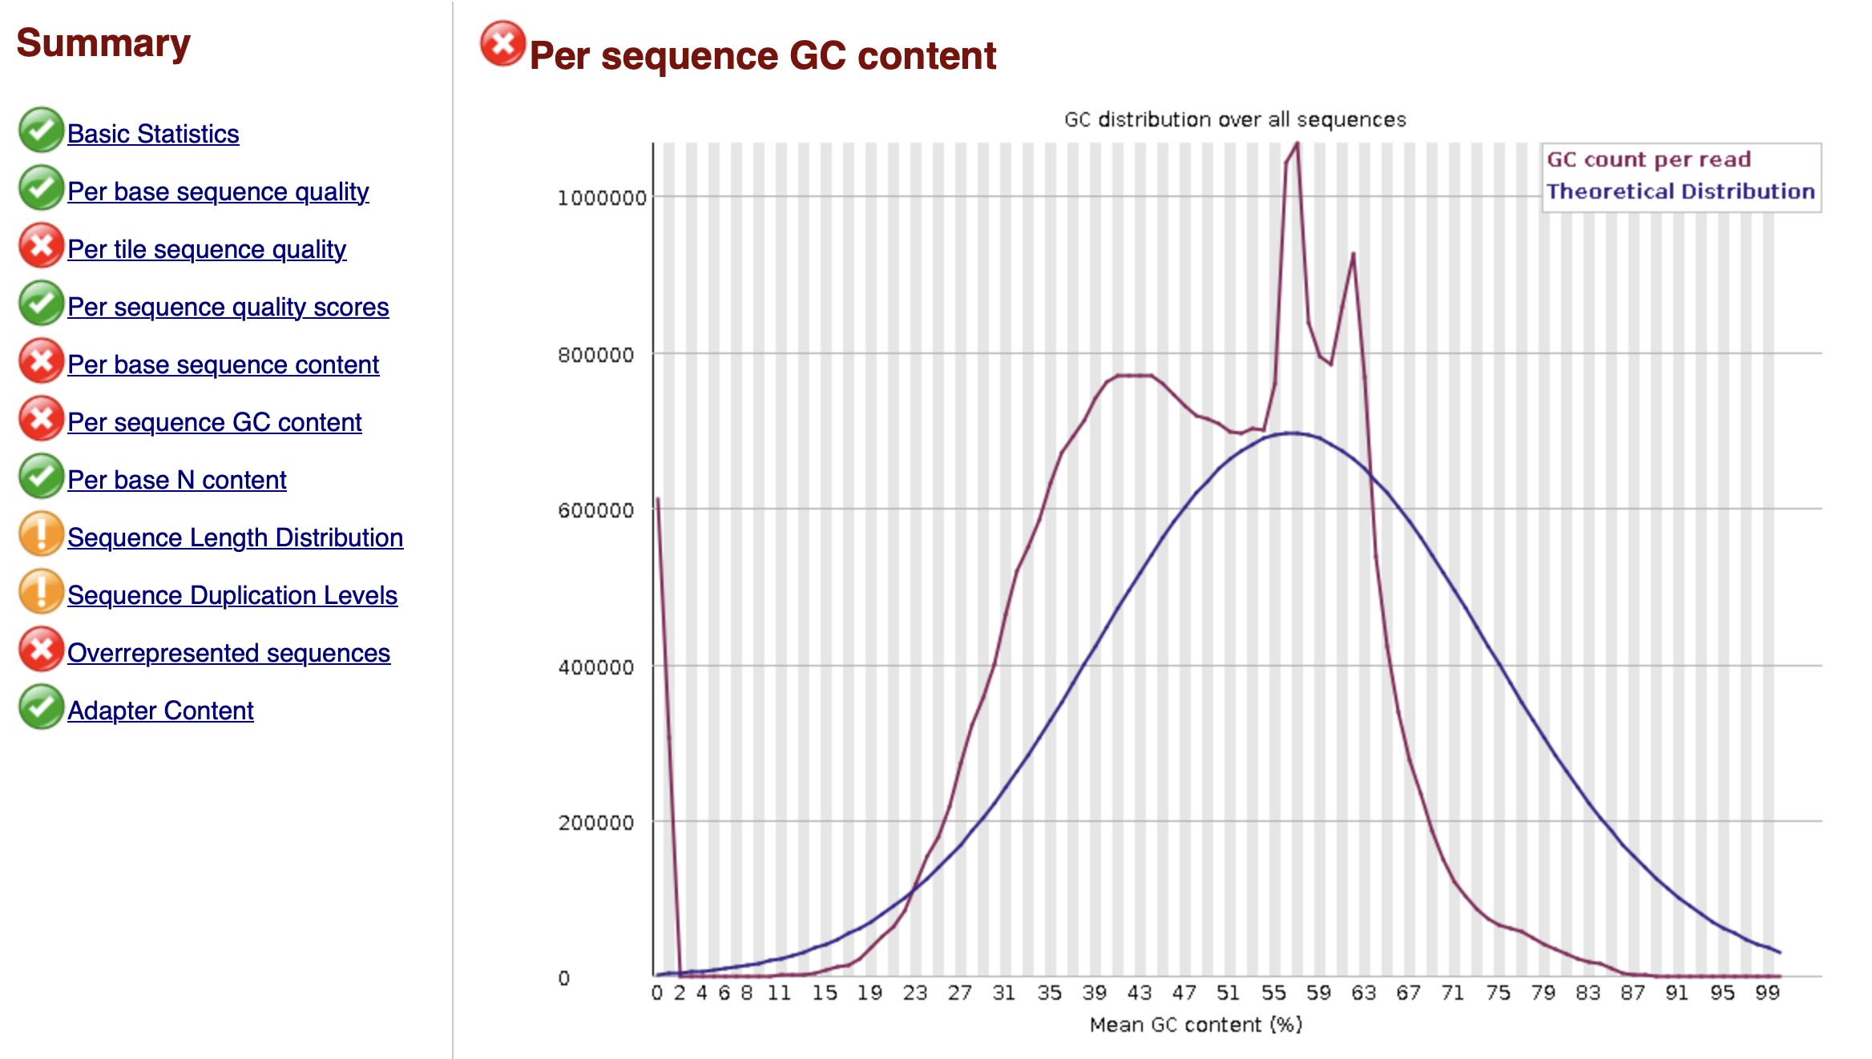
FastQC

Slide 19
The standard bulk RNA-seq workflow
Raw reads
QC
fastqc
Quality Trimming
Trimmomatic
Alignment
STAR
Feature counting
RSEM
Exploratory analysis
PCA, Heatmaps
Differential expression
DESeq2
Visualization
Volcano Plot
Pathway analysis
GSEA
topGO, KEGG, Reactome, GSEA, etc.

Slide 20
Read alignment
Reads from experiment
Reference genome
exon n
exon n+1
Read 1
Read 2
Read 1: position 147 – 158
Read 2: position 172 – 183
TCAGCAACGTAC
AACATACCATAC
GATCAGCAACGTACCGCCAGATCCGGGAACATACCATACGA
150
160
170
180
…

Slide 21
The standard bulk RNA-seq workflow
Raw reads
QC
fastqc
Quality Trimming
Trimmomatic
Alignment
STAR
Feature counting
RSEM
Exploratory analysis
PCA, Heatmaps
Differential expression
DESeq2
Visualization
Volcano Plot
Pathway analysis
GSEA
topGO, KEGG, Reactome, GSEA, etc.

Slide 22
Count features
Count features
The coordinates from alignment provide information about features
Counts give a quantitative measure for what features are represented in your data.
Calculated by counting the number of unique reads mapped to a feature
…
…
exon n
exon n+1

Slide 23
Introduction to R and RStudio

Slide 24
Working with R and RStudio
What is R?
Programming language
Primarily a functional language (as compared to object-oriented programming)
Interpreted language (similar to Python)
Originally designed for statistics
Ideal for dealing with sequencing data
Drawbacks of R
Can be slow due to being an interpreted language
Memory allocation
The biggest drawback of R. Objects are stored in physical memory which can cause errors and process failure when working with extremely large datasets.

Slide 25
Working with R and RStudio
What is Rstudio?
Integrated Development Environment (IDE)
Interfaces with the R language
Write, test, and develop scripts more efficiently
Built to work primarily with R.
Also works with Python, C++, SQL, etc.
Notes:
Open RStudio go through basic structure.

Slide 26

R/RStudio tutorial
Instructions (a graphical guide for this is included on the GitHub page – RStudio Basic Usage.pdf
Open Rstudio
Select the Project button at the top right and select “New Project” from the dropdown menu
Create a new project following the steps in the pop-up box (make a project for this workshop)
Open a new R Notebook
Modify fields in the YAML header as desired
Create code chunks (3 ways)
From dropdown: Click the chunk dropdown button and select ”R”
Use hot keys: On Mac - control+option+I. On Windows - Ctrl+Alt+I
Manually: Code chunks are designated by enclosing code with ```{r} and ```. You can type ```{r}, then your code, then ```.

Slide 27
R/RStudio tutorial
Working in an R Notebook / Markdown
You can only put code that you want run into code chunks
You can still add comments denoted by adding # at the beginning of the line you want commented out
Anything that is not executable code, e.g. comments, notes, can be written outside of code chunks using Markdown language
See the Basic RStudio Usage.pdf file or the RMarkdown cheat sheet for examples of Markdown language.
Code chunks can be run line by line inside the code chunk by putting the cursor on the line to run and selecting command+return on Mac or Ctrl+Enter on Windows
To run an entire chunk of code, click the green arrow box at the top right of the code chunk

Slide 28
R Script vs R Notebook / Markdown
R Script
Plain text document of code.
Pros
Optimal for distributing reproducible code in its final form.
Cons
Any non-code text must be commented out.
i.e., adding notes while working.
Ugly and hard to follow.
Extensive comments make it even more difficult to read.
R Notebook and R Markdown
An “authoring framework”
Create HTML or PDF documents of your code
R Notebook and R Markdown are essentially the same*
Pros
Creates a report similar to a notebook
Can easily make notes outside of the code ”chunks”
Embeds plots, figures, and tables generated from the code into the report
Cons
Slightly more memory-intensive

Slide 29
Importing data into RStudio and performing exploratory analysis

Slide 30
Data for R/RStudio
The materials for the Rstudio demo can be downloaded from the GitHub page.
Download the counts file and metadata file from the data directory
Counts: gene_expected_count.annot.txt
Metadata: metadata.csv
Download the R Markdown file from the code directory
Bulk_RNA-seq_Workshop_Oct2025.Rmd
Move the materials from your Downloads directory to the directory you created for this workshop

Slide 31
A simple primer on Dimension Reduction
 | Sample 1 | Sample 2 | Sample 3 | Sample 4 | Sample 5 | Sample 6
Gene 1 | 10 | 11 | 8 | 3 | 2 | 1
Gene 1

Slide 32
A simple primer on Dimension Reduction
 | Sample 1 | Sample 2 | Sample 3 | Sample 4 | Sample 5 | Sample 6
Gene 1 | 10 | 11 | 8 | 3 | 2 | 1
Gene 2 | 6 | 7 | 5 | 3 | 3 | 1
Gene 2
Gene 1

Slide 33
A simple primer on Dimension Reduction
 | Sample 1 | Sample 2 | Sample 3 | Sample 4 | Sample 5 | Sample 6
Gene 1 | 10 | 11 | 8 | 3 | 2 | 1
Gene 2 | 6 | 7 | 5 | 3 | 3 | 1
Gene 3 | 12 | 9 | 10 | 2.5 | 1.5 | 2
Gene 2
Gene3
Gene 1

Slide 34
Dimension Reduction can be used to see how well (or not) our sample data segregates
Principal Component Analysis (PCA) - a method to combine multiple dimensions by linearly transforming the data onto a new coordinate system.
Variance can change depending on the number of top genes used in the analysis
Other methods build on the PCA approach
t-SNE (t-distributed stochastic neighbor embedding)
UMAP (Uniform manifold approximation and projection)

Slide 35
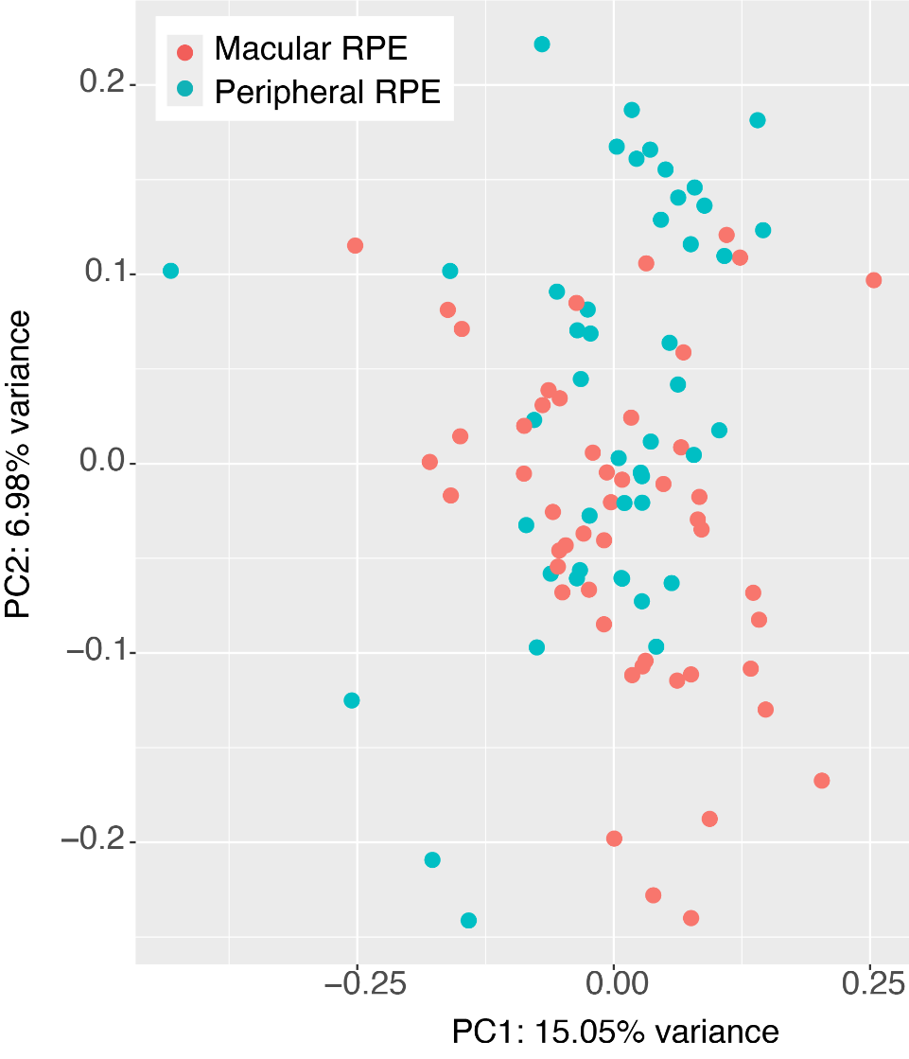
Dimension Reduction can be used to see how well (or not) our sample data segregates
Principal Component Analysis (PCA) - a method to combine multiple dimensions by linearly transforming the data onto a new coordinate system.
Variance can change depending on the number of top genes used in the analysis
Other methods build on the PCA approach
t-SNE (t-distributed stochastic neighbor embedding)
UMAP (Uniform manifold approximation and projection)

